Slide 1
A study on neural network modeling methods
to categorize the imagined speech
of words and phonemes from brain signals (EEG)
Erfan Ghobadian
Supervisor:
Dr. Yasser Shekofteh
Shahid Beheshti University

Slide 2
Introduction: Overview
Speech is one of the most important ways for human communication.
Some people lose the ability to speech due to neural dysfunctions.
Our goal is to facilitate these people’s lives.

Slide 3
Introduction: BCI
Brain-Computer Interface is a technology that connects the brain directly to a computer or device, allowing users to control the device with their thoughts.
Works by measuring electrical activity in the brain and translating it into commands that can control a computer or device.
This can be achieved through various methods such as electroencephalography (EEG), magnetoencephalography (MEG), and functional magnetic resonance imaging (fMRI).
BCI has a wide range of potential applications, including medical rehabilitation, gaming, and communication for people with disabilities.
In medicine, BCI can be used for controlling prosthetic limbs, reducing symptoms of conditions such as epilepsy, and etc.

Slide 4
Introduction: Brain Activity Records - Methods
Invasive: Invasive Brain Activity Signals are electrical signals recorded directly from the brain using electrodes implanted into the brain tissue.
Non-invasive: Non-invasive Brain Activity Signals are electrical signals recorded from the scalp, which reflect the electrical activity of the brain underneath.
Invasive Brain Activity signals provide a higher resolution and more accurate representation of brain activity compared to non-invasive methods such as EEG. However, invasive brain activity signals are not without their challenges as the implantation of electrodes into the brain is invasive and carries risks such as infection and brain damage

Slide 5
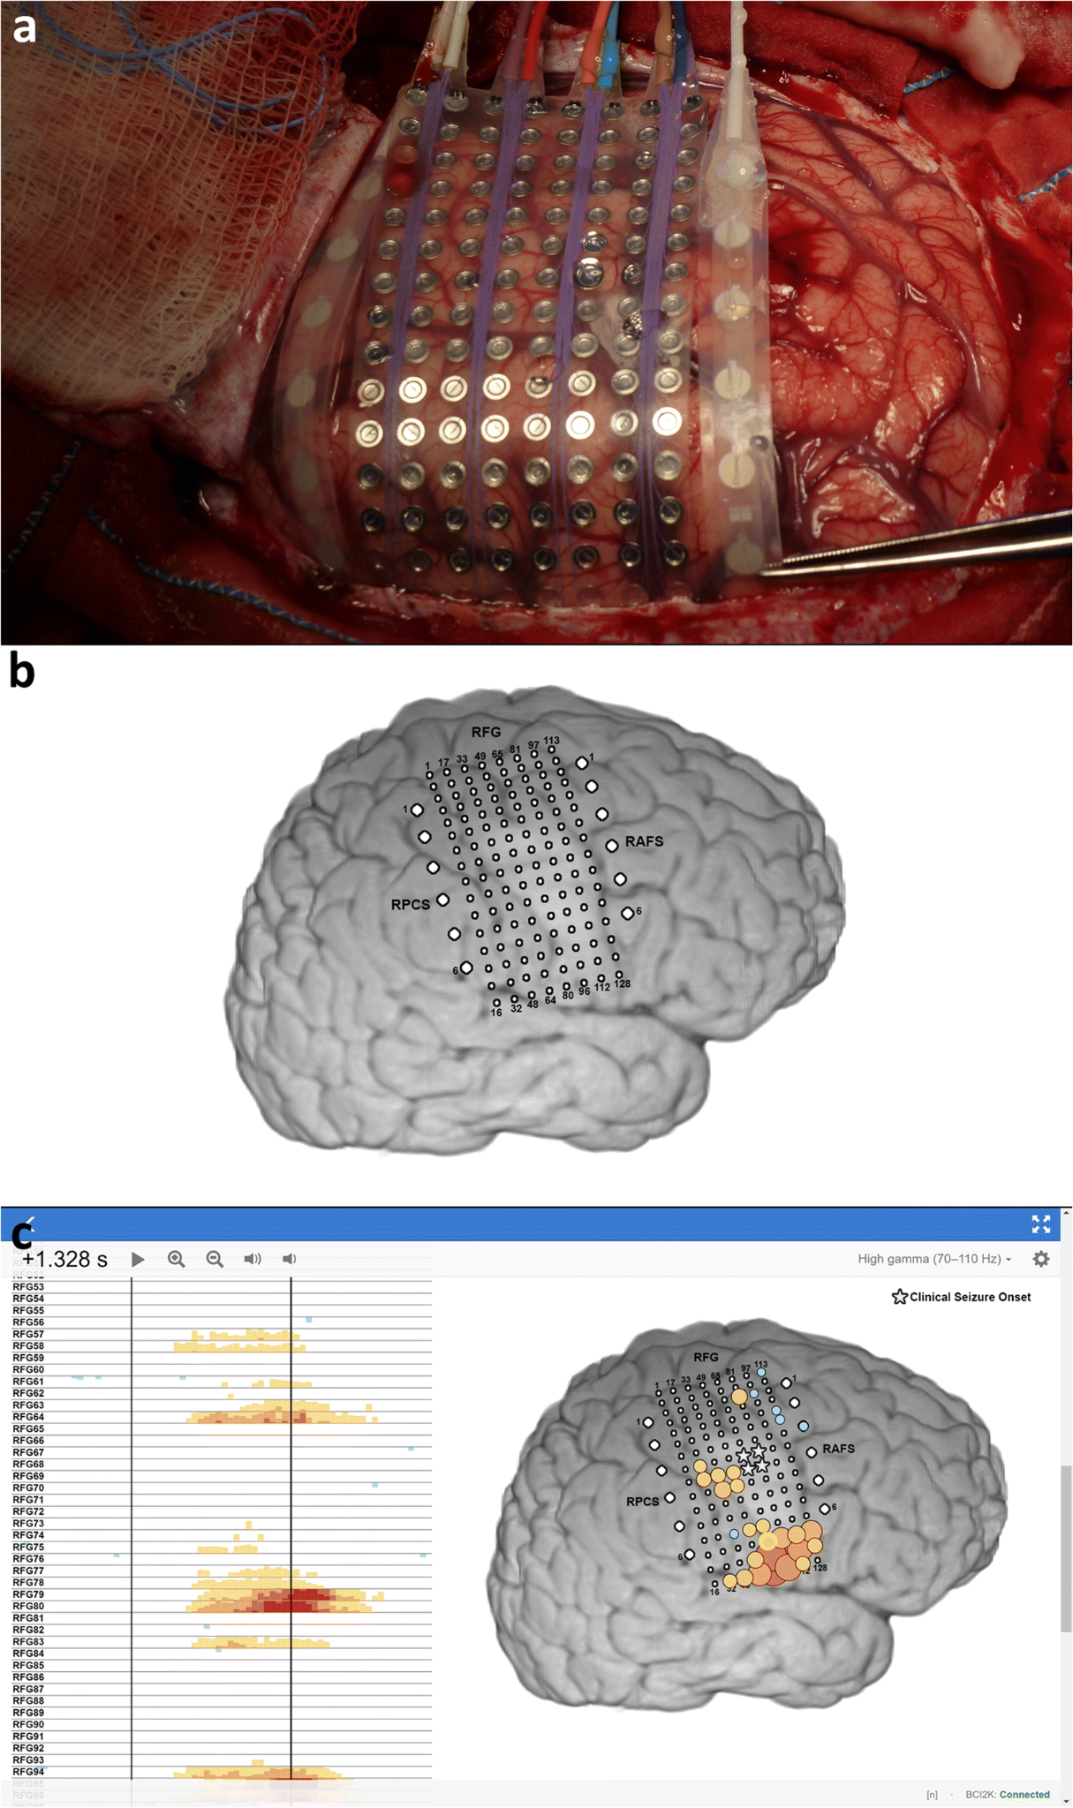
Introduction: Brain Activity Records - Invasive: ECoG
Electrocorticography (ECoG) is a type of brain activity recording that uses electrodes placed on the surface of the brain to measure the electrical activity of the cortex.
Unlike non-invasive methods such as EEG, ECoG provides a higher resolution and more accurate representation of brain activity.
ECoG electrodes are typically placed on the surface of the brain, either during brain surgery or through a minimally invasive procedure.
The electrodes measure the electrical signals generated by the firing of neurons in the cortex and transmit them to a recording device for analysis.

Slide 6
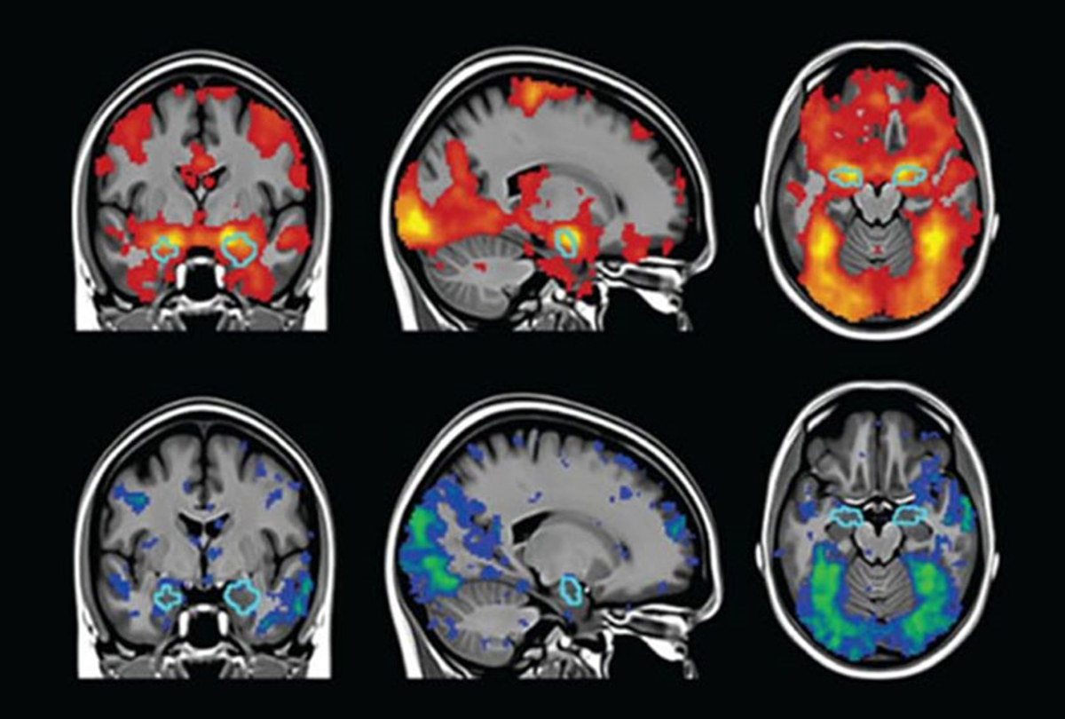
Introduction: Brain Activity Records - Non-Invasive: fMRI
Functional Magnetic Resonance Imaging (fMRI) is a type of brain imaging that uses magnetic fields and radio waves to measure blood flow in the brain.
fMRI works by measuring changes in blood flow in response to neural activity in the brain.
When a brain region is active, the increased demand for oxygen and glucose results in an increase in blood flow to the area.
fMRI detects these changes in blood flow and maps them to the underlying brain activity.

Slide 7
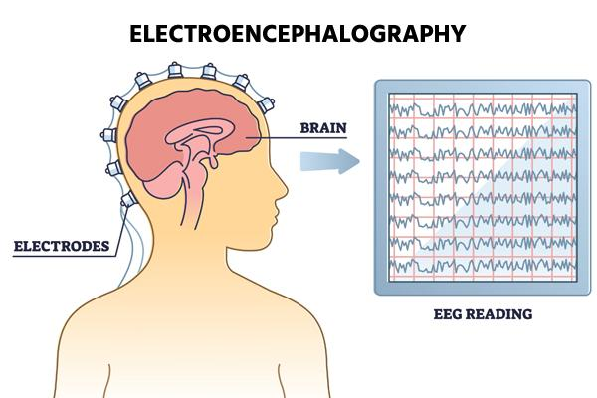
Introduction: Brain Activity Records - Non-Invasive: EEG
Electroencephalography (EEG) is a type of brain imaging that records the electrical activity of the brain through electrodes placed on the scalp.
EEG records the electrical signals generated by neurons in the brain and maps them to the underlying brain activity.
EEG is also cost-effective and portable, making it a valuable tool for large-scale studies and field research.

Slide 8
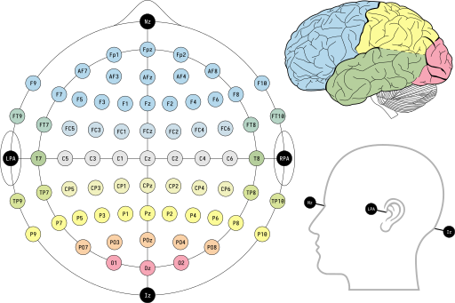
Introduction: EEG Channels
Typical EEG systems can have as few as a single channel to as many as 256 channels. Electrode placement on the head adheres to a formal standard called the 10/20 system or International 10/20 system.

Slide 9
Introduction: Imagined Speech
“hearing” one’s own voice silently to oneself, without the intentional movement of any extremities such as lips, tongue, or hands
Usage:
Clinical tool to assist those with severe paralysis.
“Synthetic telepathy” for the military.
General purpose communication.

Slide 10
Introduction: State of Art
Edmond M. Dewan discovered the we could voluntarily control the alpha wave of the EEG signal. He used morse Code in his System in Order to obtain letters and finally conduct words. (1967)
P.R. Kennedy et al. obtained a functional system that uses the movement of a cursor as a form of communication. (2000)
These approaches represent an inconvenient way to communicate since it takes a long time to form a word.

Slide 11
Introduction: State of Art
Recent studies focused on finding pattern in EEG signals rather than finding a trigger.
Marek Wester reached 50% accuracy in multiple class classification. However, the group later revealed that the experiment process favored the results because the signal acquisition protocol assumed to speak or think the exact stimulus multiple consecutive times, and this accidentally creates temporal correlation in EEG signals. (2006)

Slide 12
KaraOne Dataset: Overview
14 participants (mean age = 27.4, σ = 5, range = 14) were recruited from the University of Toronto campus.
All participants were right-handed, and had no history of neurological conditions or substance abuse.
10 participants identified NA English as their native language and 4 spoke NA English at a fluent level.
collected audio, facial (from the Kinect) and EEG data of vocalized and imagined speech.
7 phonemic/syllabic prompts: /iy/, /uw/, /piy/, /tiy/, /diy/, /m/, /n/
4 words: pat, pot, knew, gnaw
Each prompt was presented 12 times, for a total of 132 trials per person

Slide 13
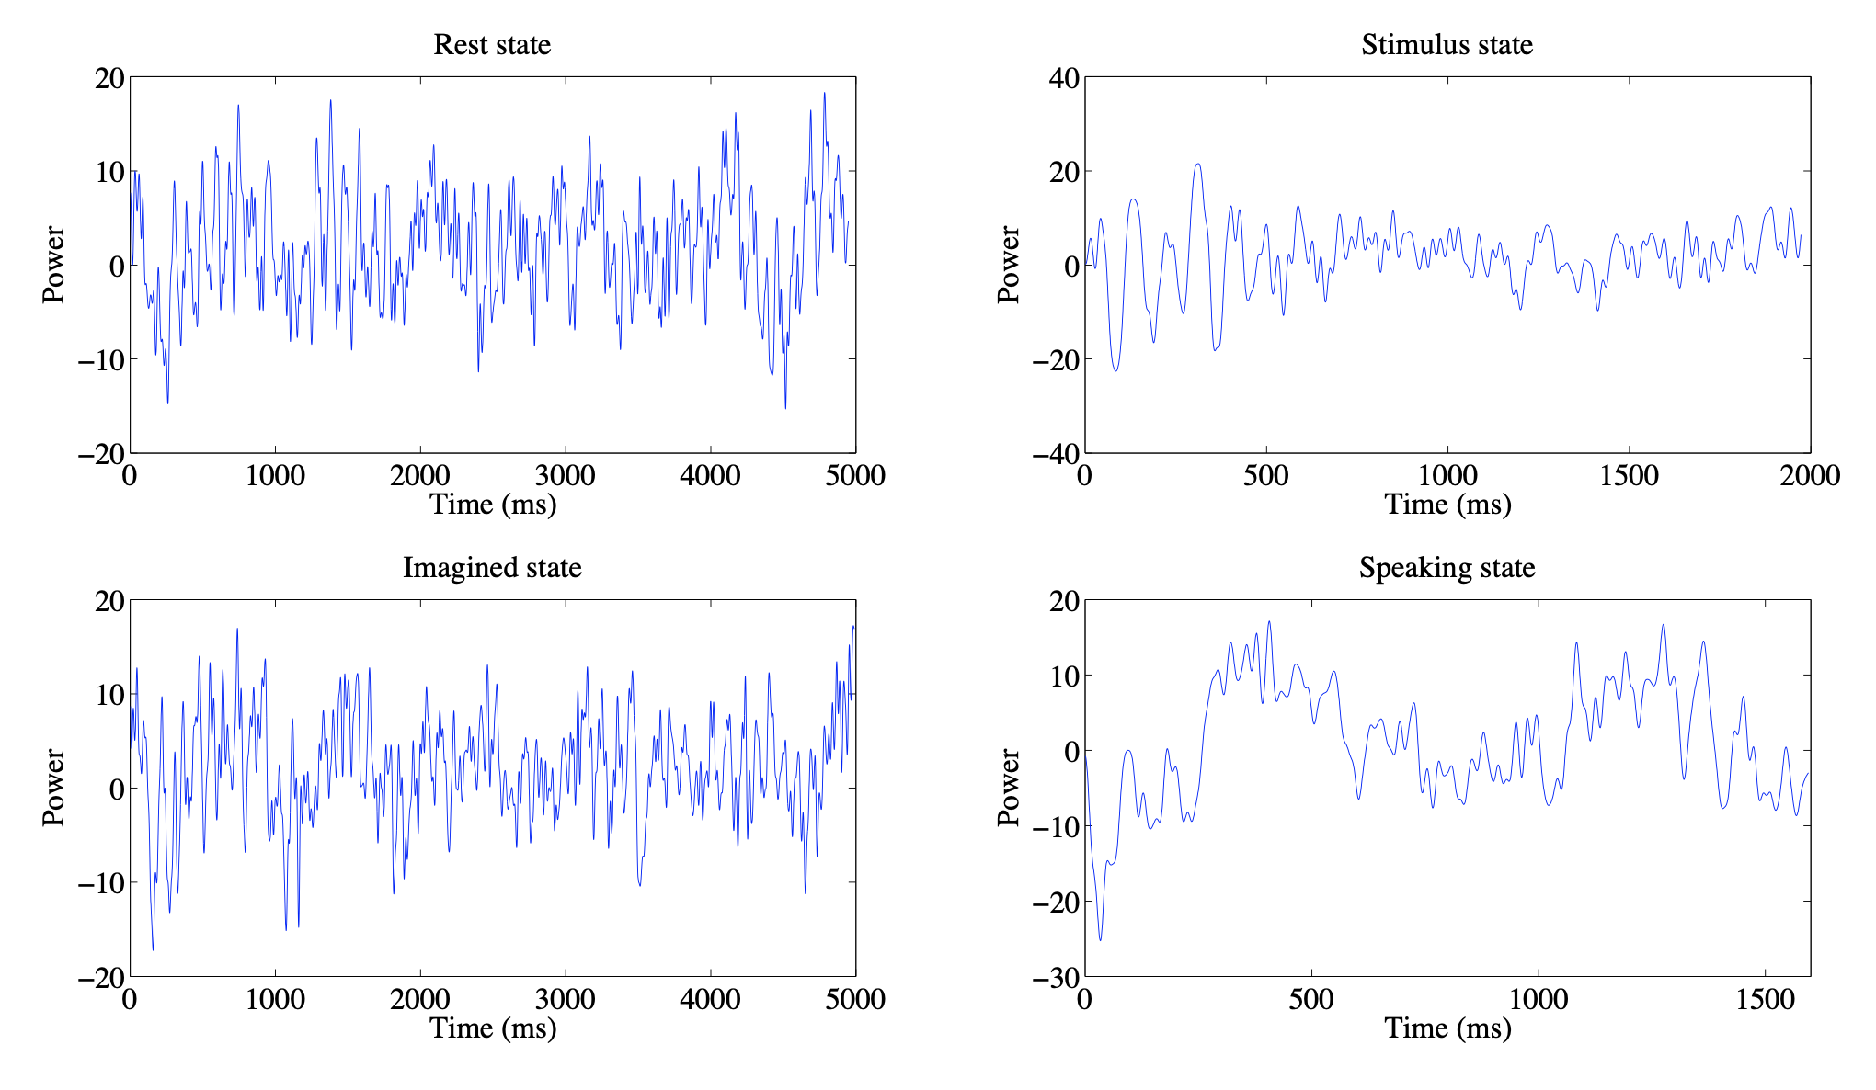
KaraOne Dataset: Recording Details
Rest state: (5 sec.) Participants were instructed to clear their mind.
Stimulus state: A prompt appeared on the screen and was played over the computer’s speakers. Participants were instructed to move their articulators into position to begin pronouncing the prompt.
Imagined state: (5 sec.) Participants imagined speaking the prompt without moving.
Speaking state: Participants spoke the prompt aloud.

Slide 14
KaraOne Dataset: Tasks
Considering the 5 binary classification tasks:
Vowel-only vs. consonant (C/V)
Presence of nasal (±Nasal)
Presence of bilabial (±Bilab.)
Presence of high-front vowel (±/iy/)
Presence of high-back vowel (±/uw/)

Slide 15
KaraOne Dataset: Results
Computed various statistical features over 10% of the segment windows with 50% overlap, including mean, median, standard deviation, variance, etc.
They used the SVM-quad classifier.
maximum accuracy over the /uw/ phoneme: 79.16%.
minimum accuracy when classifying consonants versus vocals: 18.08%.

Slide 16
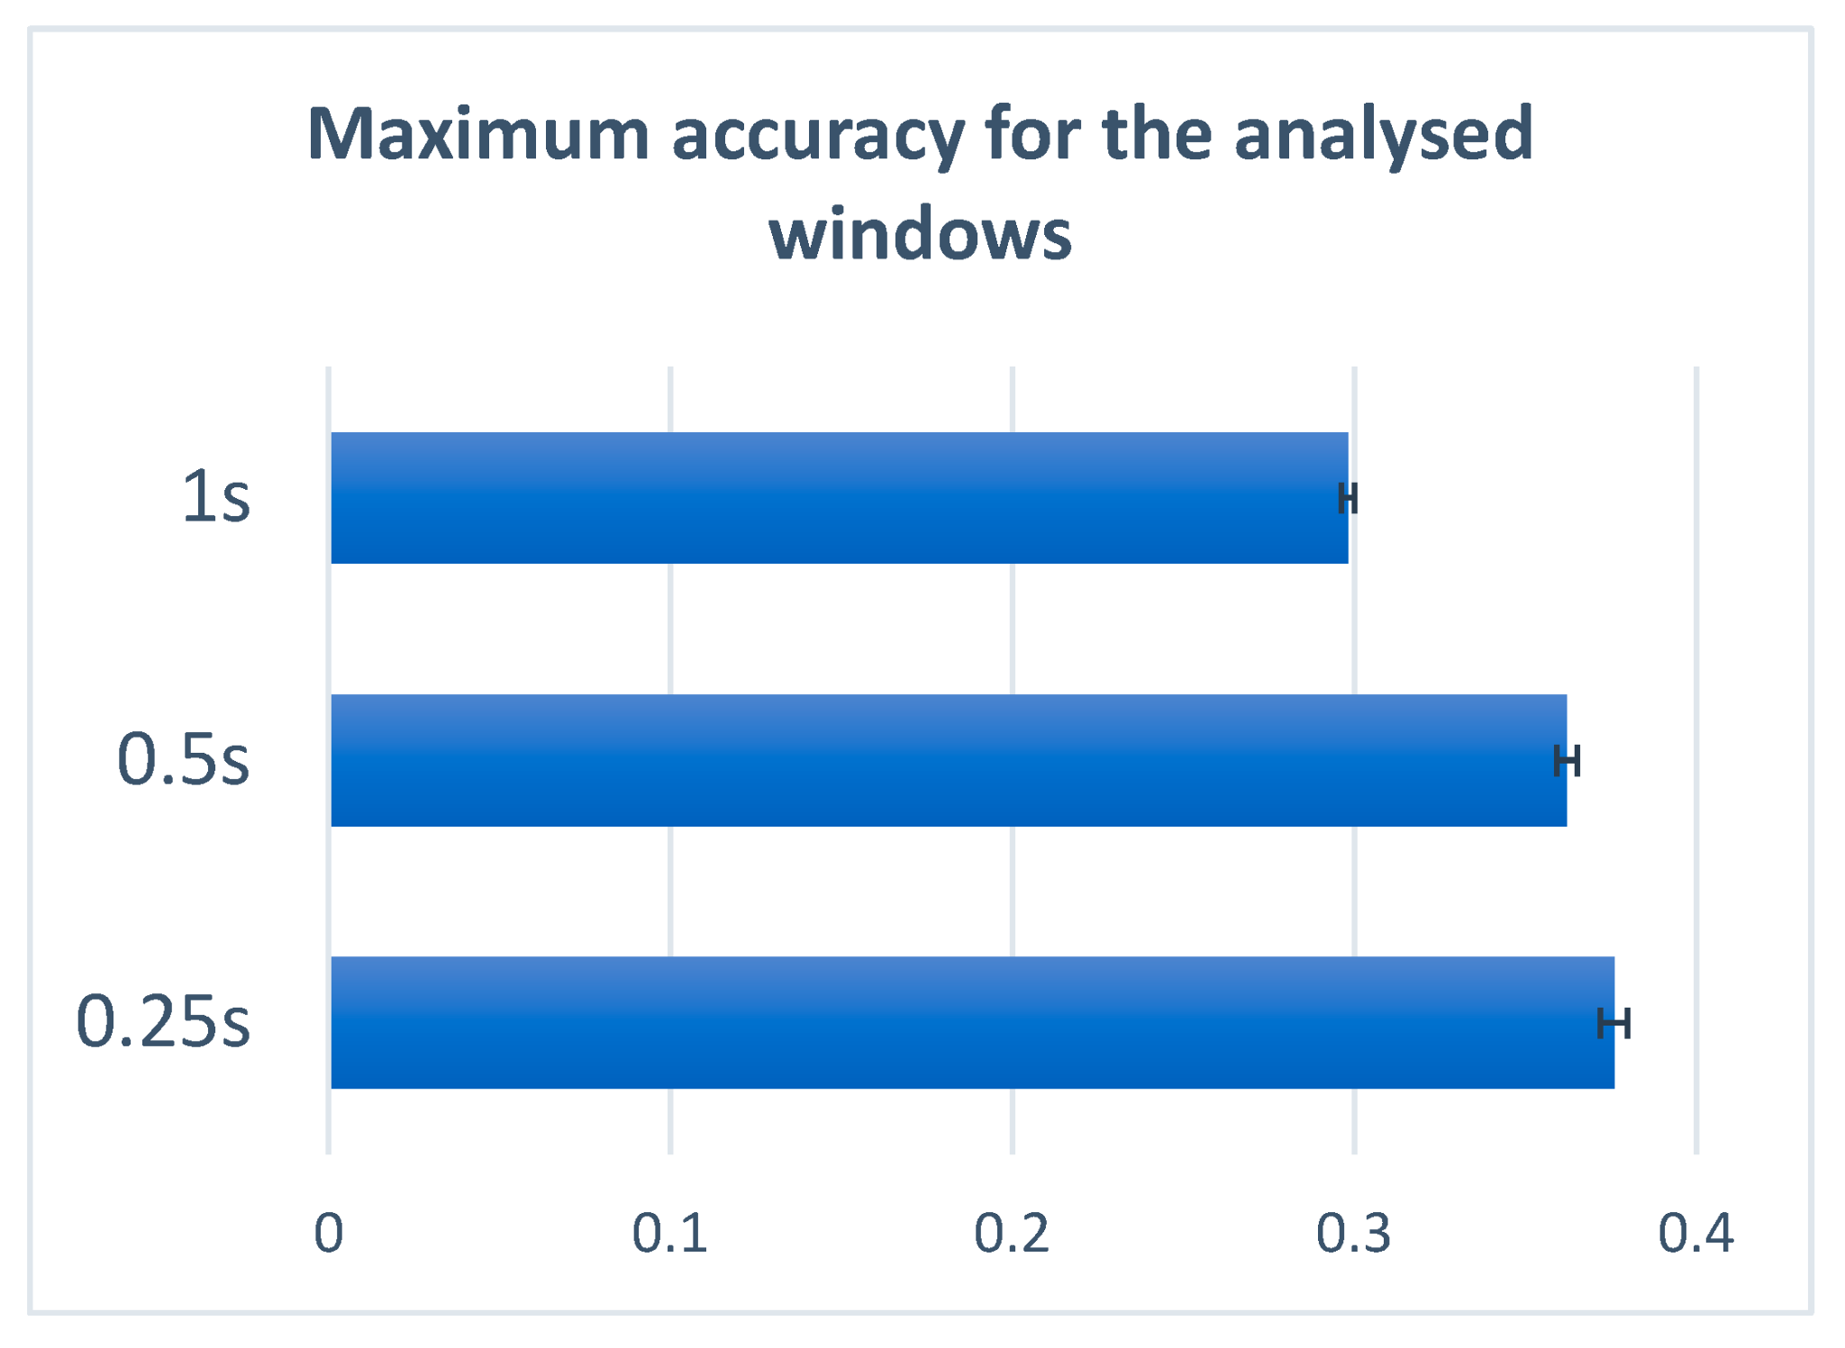
Feature Extraction: Methods
Analyzed the performance of the system when using the time vs frequency domain feature extraction methods. Another comparison study conducted in this stage was based on computing the features using 0.25s non-overlapping time frame.
The 0.25s time frame window was used as in which the signal is quasi-stationary, but also contains all the needed information regarding the utterance.
Signals corresponding to the 5 s state of imaginary speaking of the prompt. eliminated the first and last 0.5s of the signal (transition state), obtaining a 4 s signal in the end.
Used 62 electrodes. The electrodes and their position in the 10-20 system signals were filtered using a notch filter in order to remove the 60 Hz power line artifact and all multiples of 60 Hz smaller than the Nyquist frequency.

Slide 17
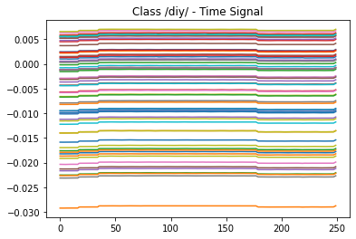
Feature Extraction: Raw EEG Windowed Signal
Windowed the the trials by 0.25s time frame, obtaining 16 images of (62, 250).
50% of all images randomly distributed to the Test data and the other 50% splitted to 70% training and 30% validation.
Train Shape: X:(10712, 62, 250), Y:(10712, 11)
Validation Shape: X:(4592, 62, 250), Y:(4592, 11)
Test Shape: X:(15304, 62, 250), Y:(15304, 11)

Slide 18
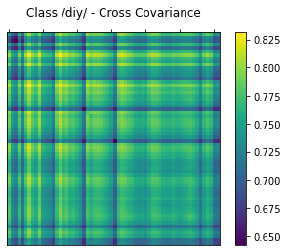
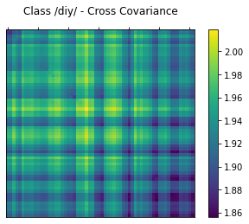
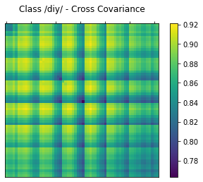
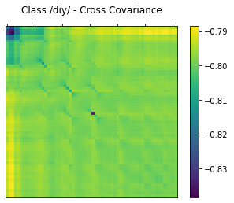
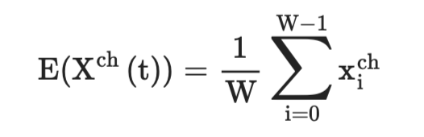
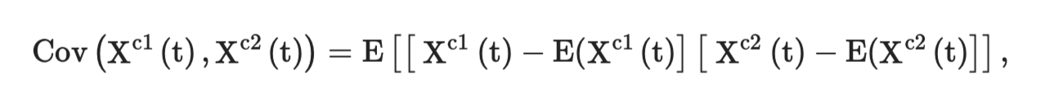
Feature Extraction: Cross Covariance Time Domain
Windowed the the trials by 0.25s time frame, obtaining 16 images of (62, 250). Computing the Cross Covariance Matrix to get the correlations between different channels.
Train Shape: X:(10712, 62, 62), Y:(10712, 11)
Validation Shape: X:(4592, 62, 62), Y:(4592, 11)
Test Shape: X:(15304, 62, 62), Y:(15304, 11)

Slide 19
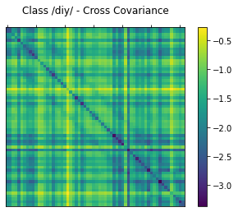
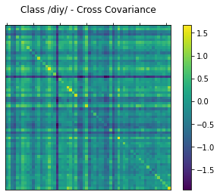
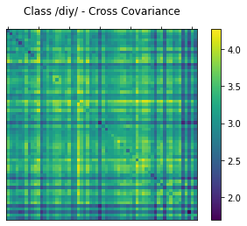
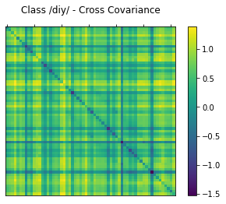
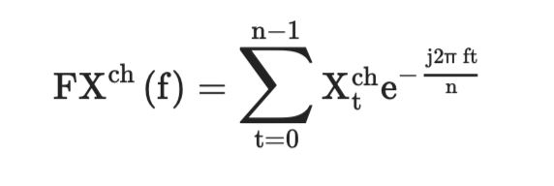
Feature Extraction: Cross Covariance Frequency Domain
Windowed the the trials by 0.25s time frame, obtaining 16 images of (62, 250). Computing FFT correspond to each Signal which gives (62, 125) images in frequency-domain and finally, computing the Cross Covariance Matrix to get the correlations between different channels.
Train Shape: X (10712, 62, 62), Y (10712, 11)
Validation Shape: X (4592, 62, 62), Y (4592, 11)
Test Shape: X (15304, 62, 62), Y (15304, 11)

Slide 20
Classification: Methods
CNN shows a great success in understanding biomedical images for classification, segmentation, detection and localization for different types of input images, offers a great false prediction rate in systems based on EEG signals.
CNN widely used in BCI systems for imaginary motion recognition.
We tested different architectures of the CNN neural network with the the purpose of finding the one offering the best performance with respect to the complexity, memory and running time.

Slide 21
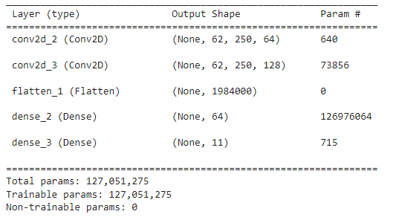
Classification: CNN Conv(64, 128)

Slide 22
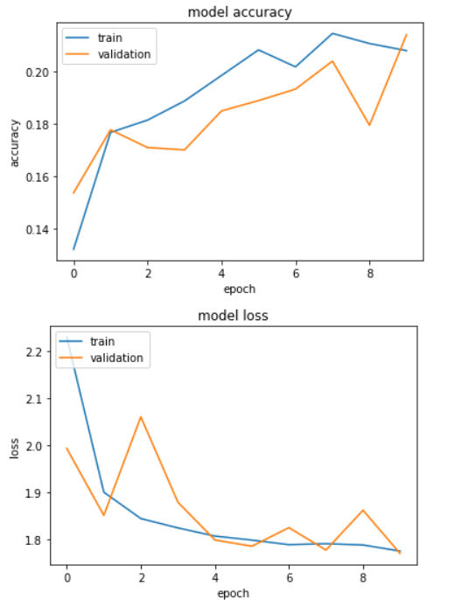
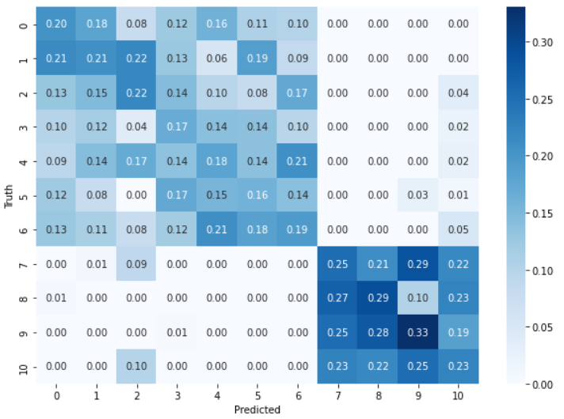
CNN Conv(64, 128) - Raw EEG Windowed Signal

Slide 23
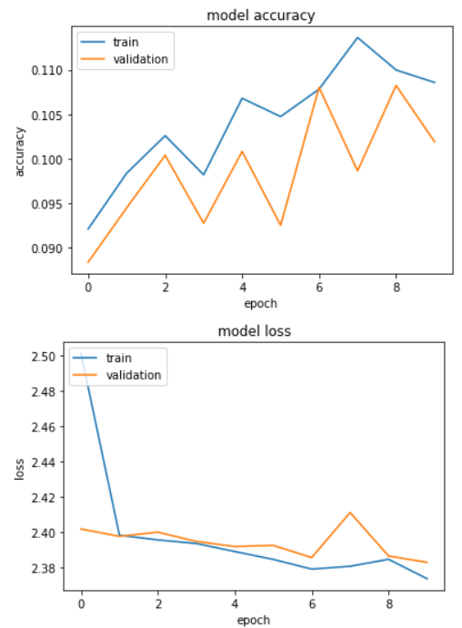
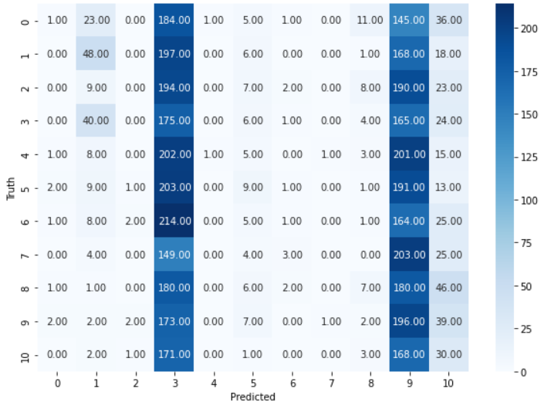
CNN Conv(64, 128) - Cross Covariance Time Domain

Slide 24
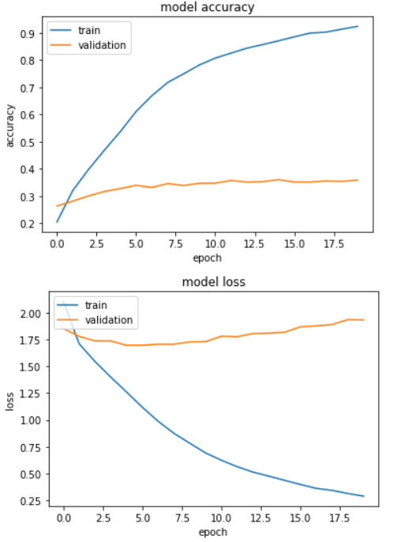
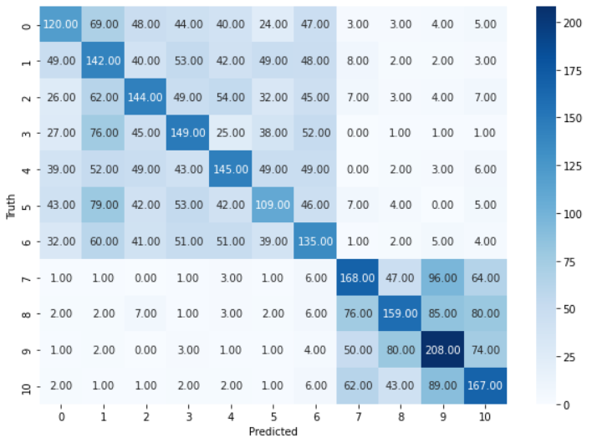
CNN Conv(64, 128) - Cross Covariance Frequency Domain

Slide 25
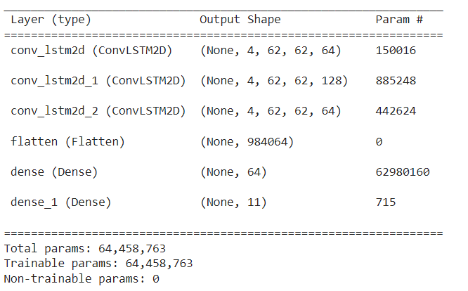
CNN + LSTM Conv(64, 128, 64) - Cross Covariance Frequency Domain

Slide 26
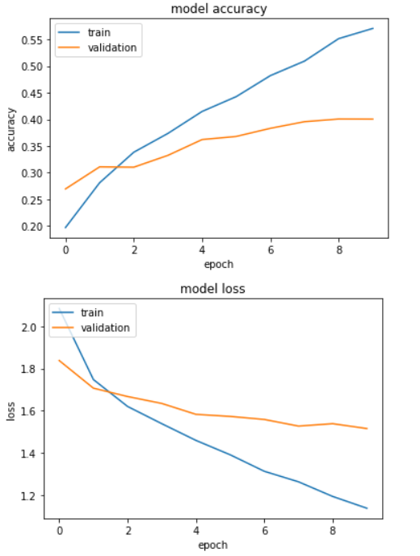
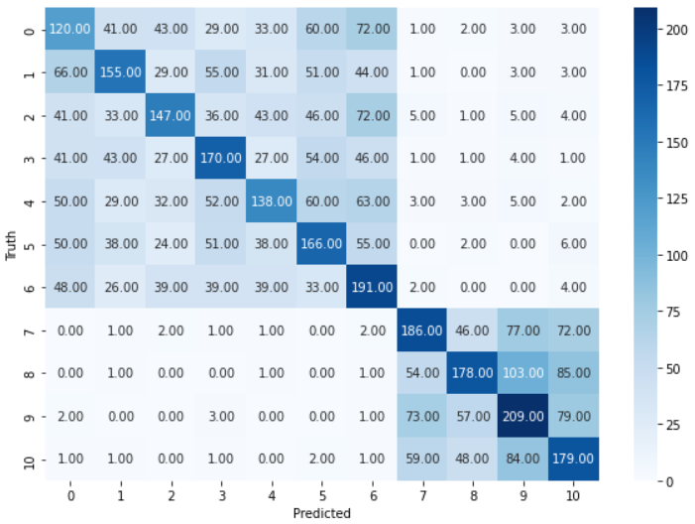
CNN + LSTM Conv(64, 128, 64) - Cross Covariance Frequency Domain

Slide 27
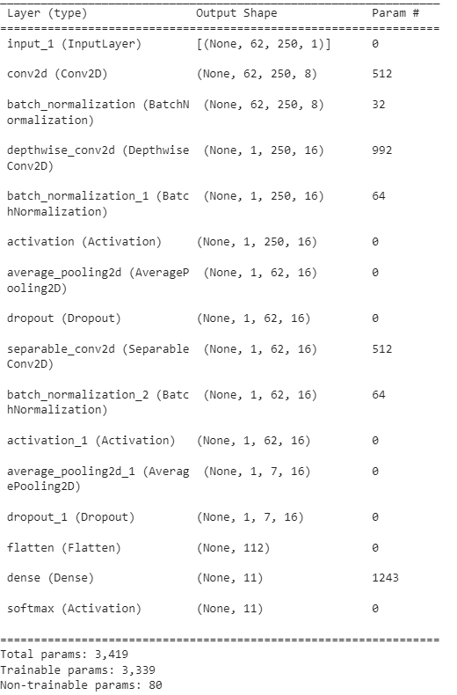
Classification: EEGNet
EEGNet is a deep learning model designed specifically for EEG analysis.
It is a shallow network, with a small number of parameters, making it suitable for real-time analysis.
The network uses depth-wise separable convolutions, which significantly reduces the number of parameters compared to traditional convolutional neural networks.

Slide 28
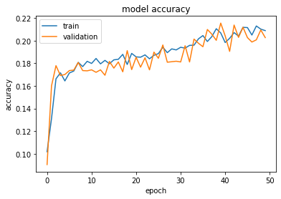
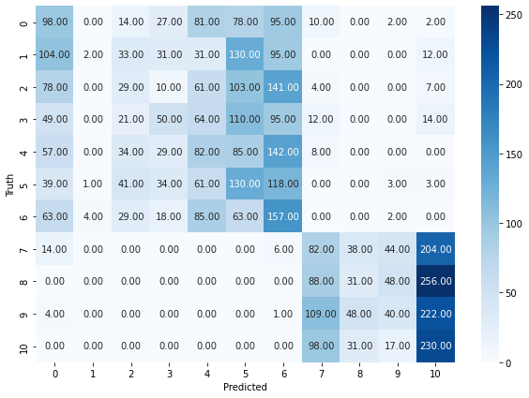
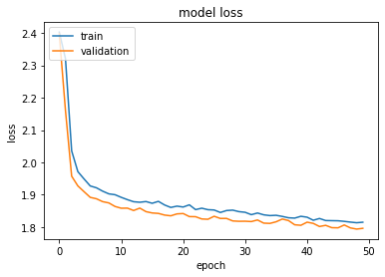
EEGNet - Raw EEG Windowed Signal

Slide 29
Classification: Results
 | Accuracy | Balanced Accuracy | Recall | Kappa
Raw Signal + CNN | 15.66 | 15.82 | 15.82 | 0.07
Time Domain Cross-Covariance + CNN | 9.61 | 9.60 | 9.60 | 0.05
Freq. Domain Cross-Covariance + CNN | 43.34 | 43.35 | 43.35 | 37.5
Freq. Domain Cross-Covariance + CNN + LSTM | 32.91 | 32.83 | 32.90 | 29.5
Raw Signal + EEGNet | 15.39 | 15.37 | 15.3 | 6.9

Slide 30
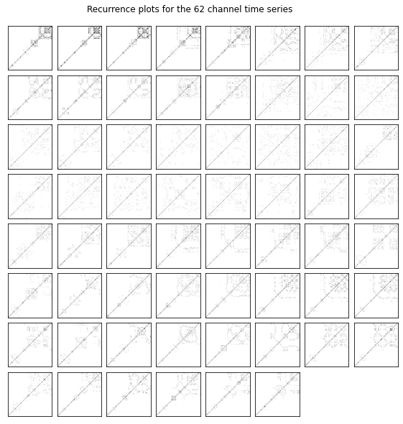
Future Works: Recurrence Plot

Slide 31
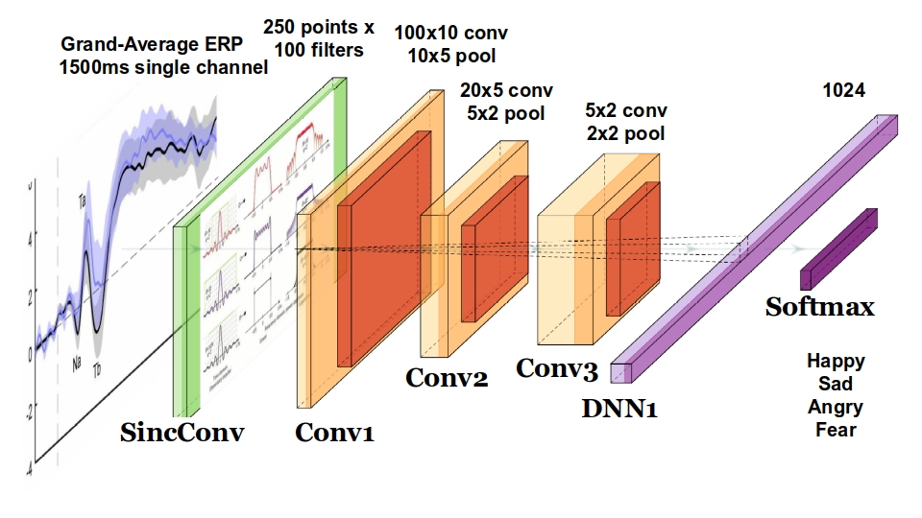
Future Works: SincNet

Slide 32
End
Any Questions?
https://github.com/erfanghobadian/imagined-speech-classification
https://colab.research.google.com/drive/1yaGFQQ8uyUbGtqxsSup6MWqfkMfPOLna?authuser=1#scrollTo=ePj15H9K0NKo

